Slide 1
enhancing antimicrobial resistance prediction with convolutional neural networks

Slide 2
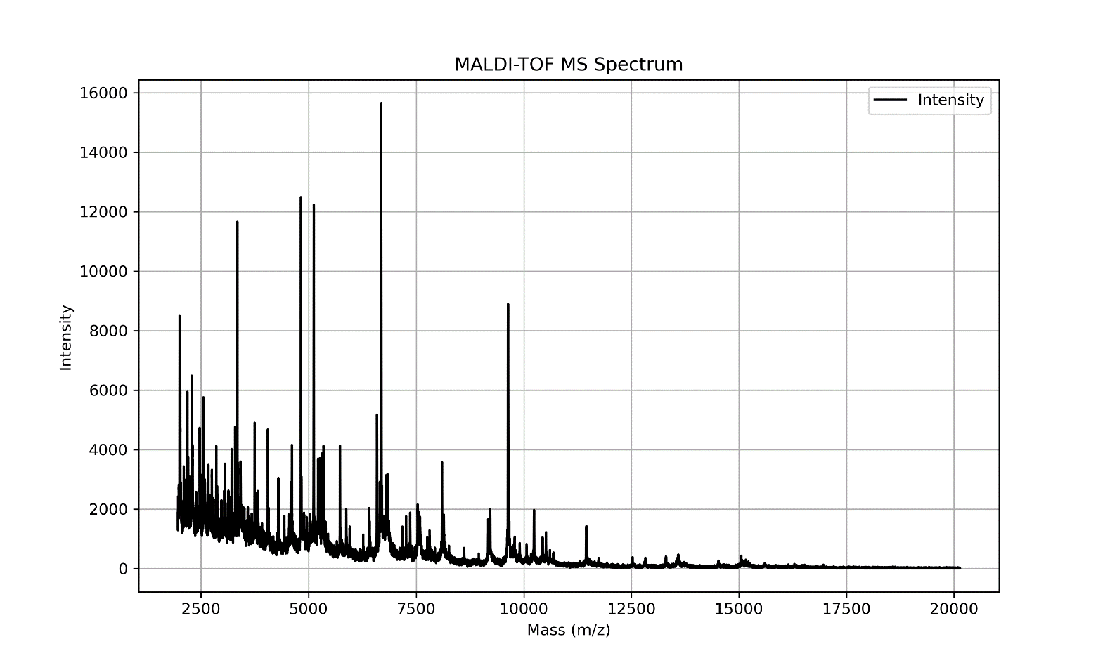
The data
The DRIAMS-A dataset was gathered from 2016 to 2018, primarily from the University Hospital Basel, Switzerland. It includes 145,341 mass spectra representing 803 different species of bacterial and fungal pathogens.
The data spans over 71 different antimicrobial drugs, and each sample has associated antimicrobial resistance labels that classify them as susceptible, intermediate, or resistant.

Slide 3
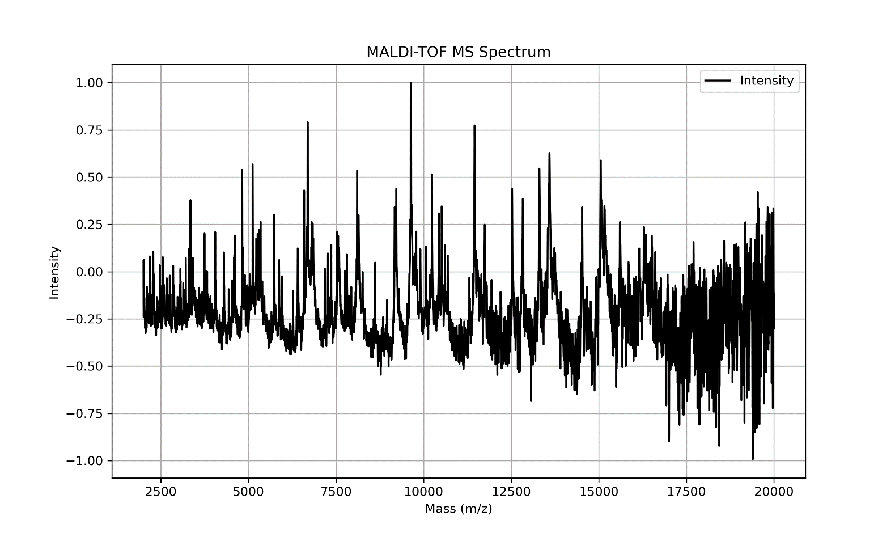
The data
LOWESS Smoothing:
First Smoothing: Applies tight locality LOWESS to finely capture local trends in data.
Second Smoothing: Utilizes a broader locality to smooth over larger data spans, helping to identify general trends.
Normalization and Scaling
Normalization: Ratios the 'intensity' against the second smoothed data to normalize variations.
Rescaling: Adjusts the normalized data to a new scale between -1 and 1, making data uniform in scale.
Final Data Transformation
Extended LOWESS Fit: Conducts additional LOWESS smoothing across a newly defined range of mass values to generate a finely smoothed curve.

Slide 4
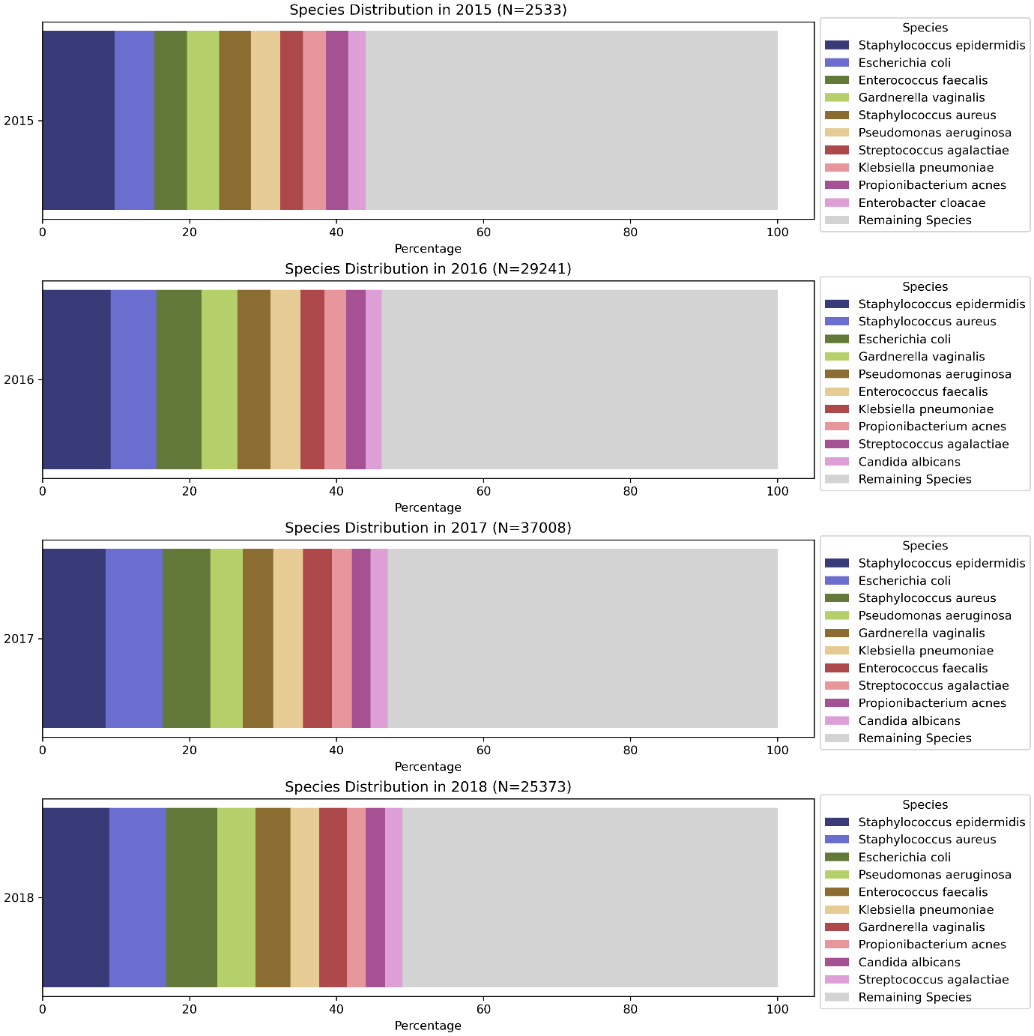

Slide 5
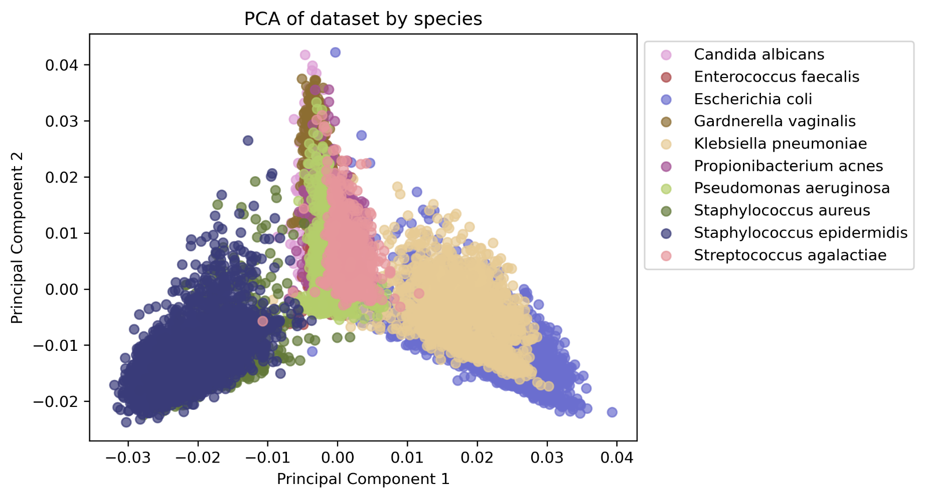
Species

Slide 6
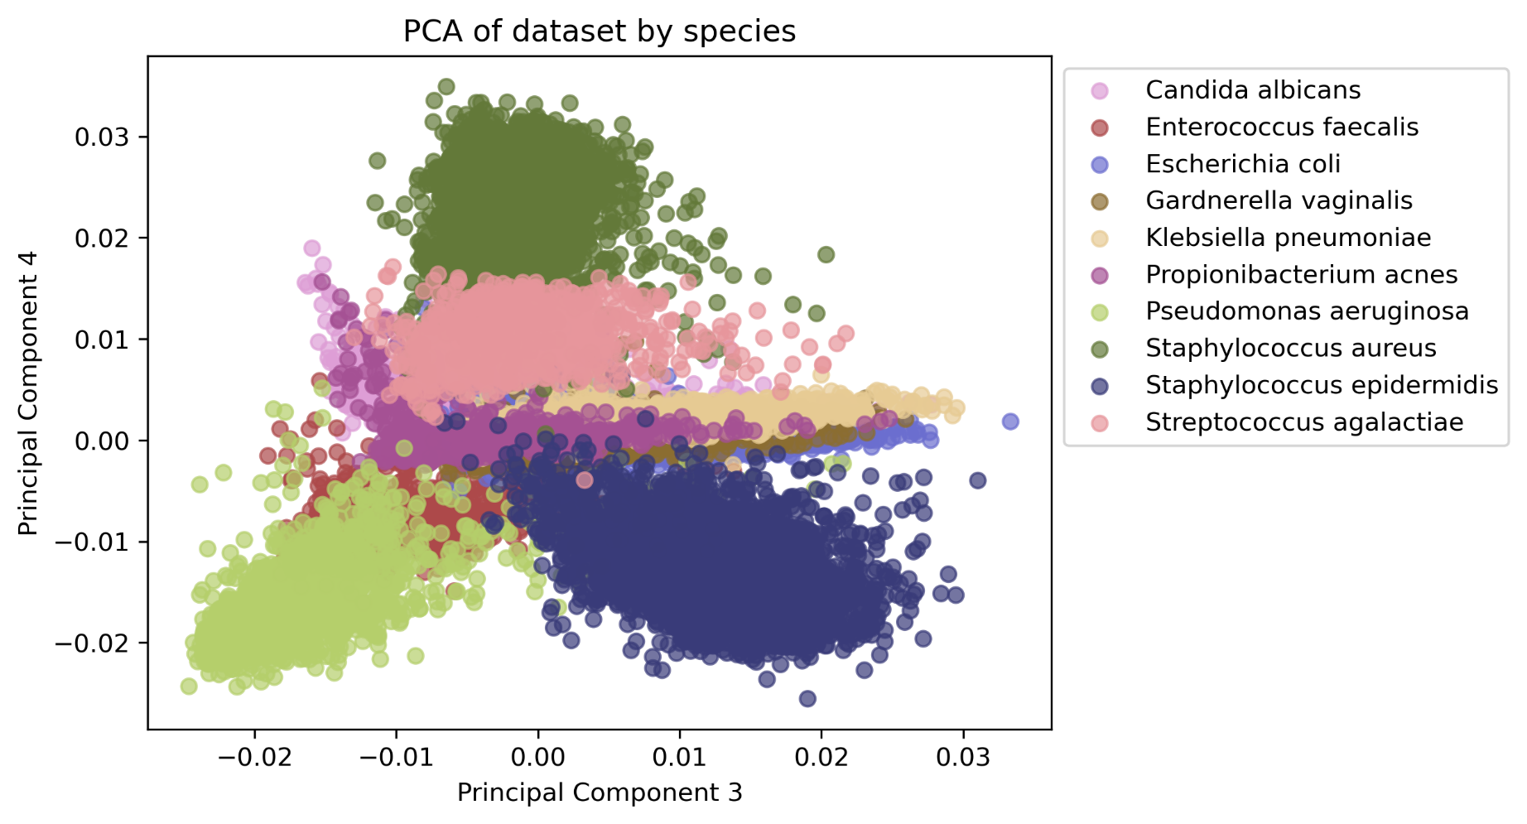
Species

Slide 7
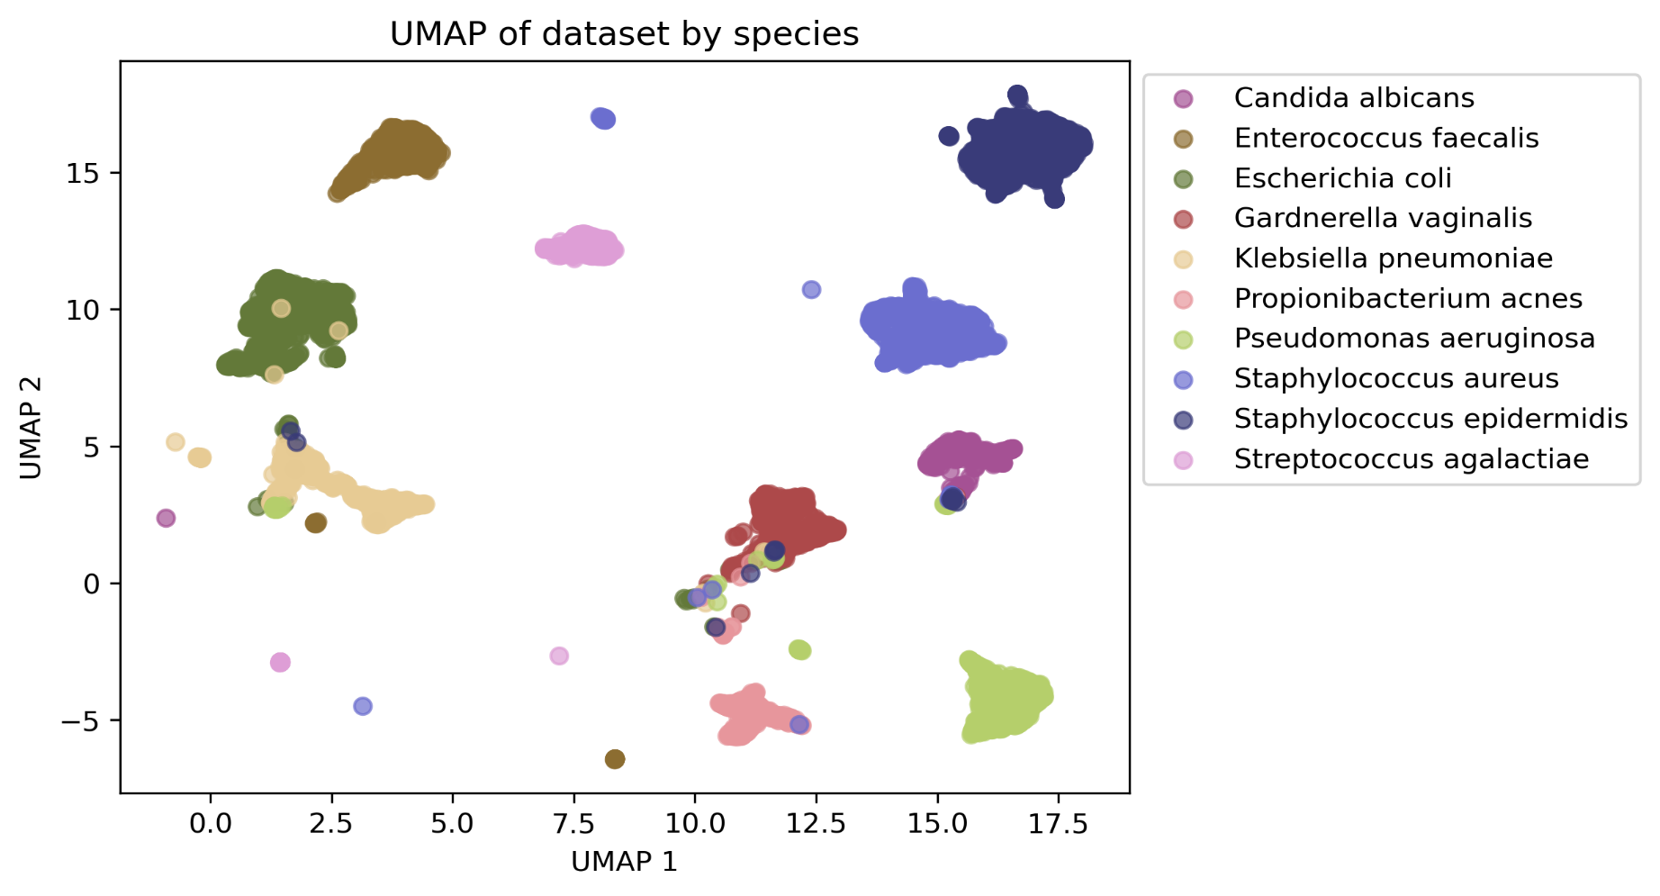
Species

Slide 8
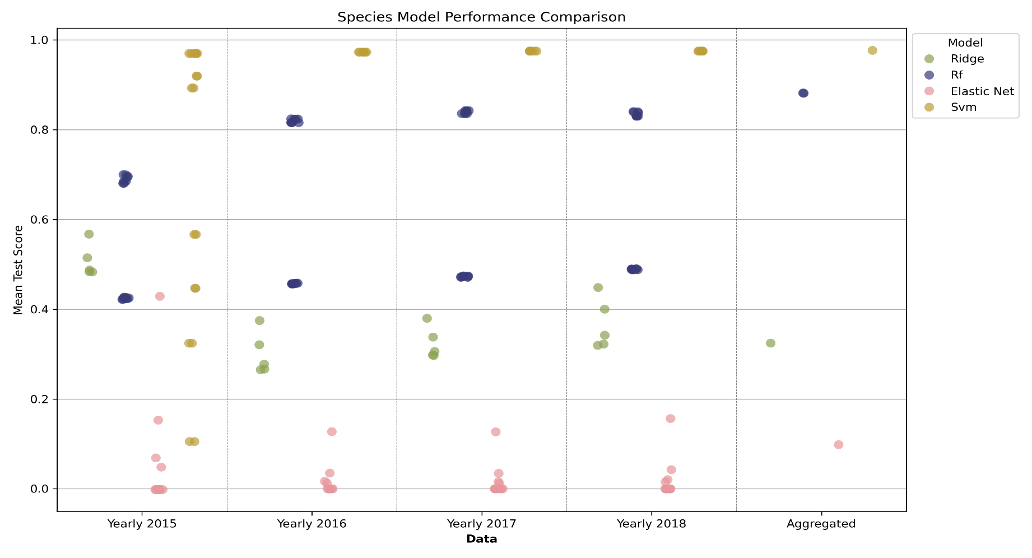
Species

Slide 9
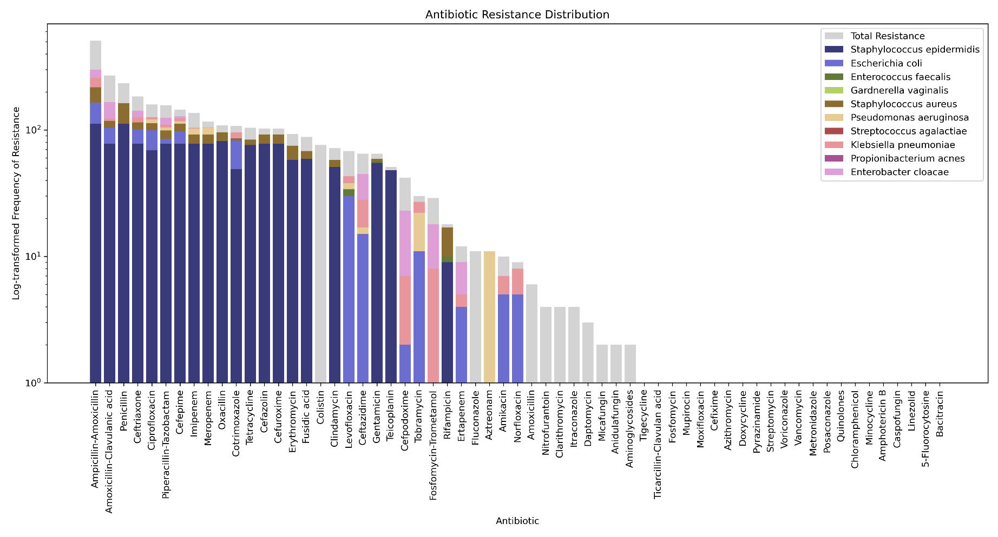
Antimicrobial resistance
2015 data

Slide 10
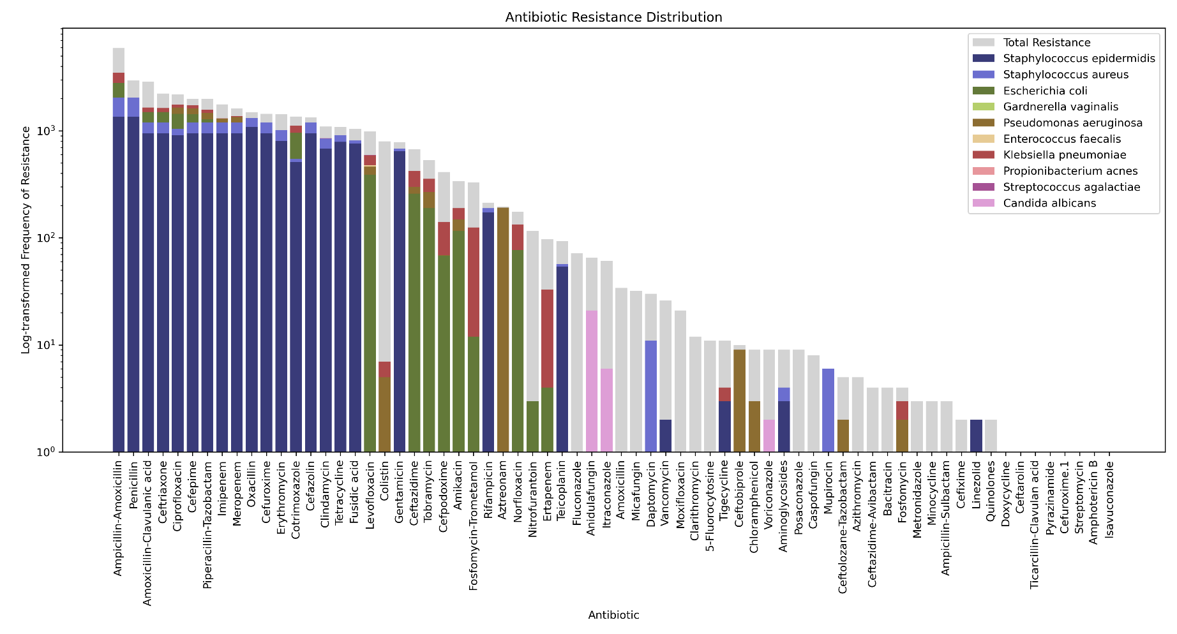
Antimicrobial resistance
2016 data

Slide 11
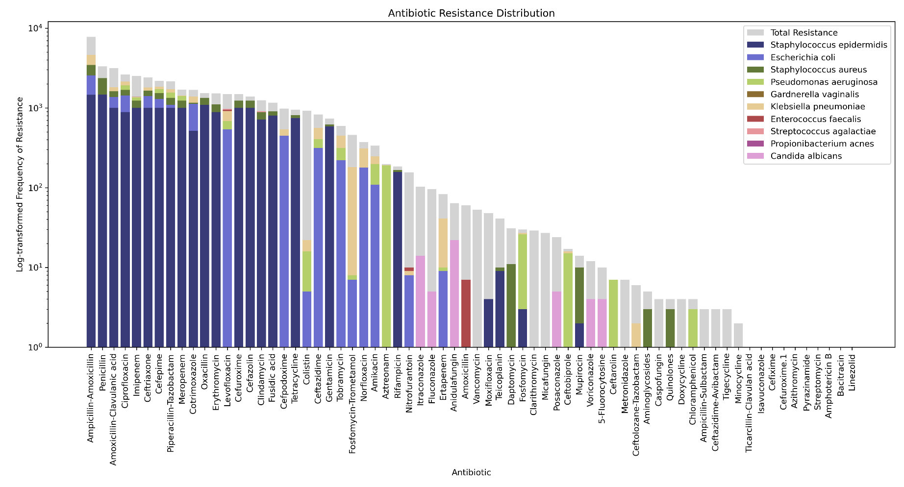
Antimicrobial resistance
2017 data

Slide 12
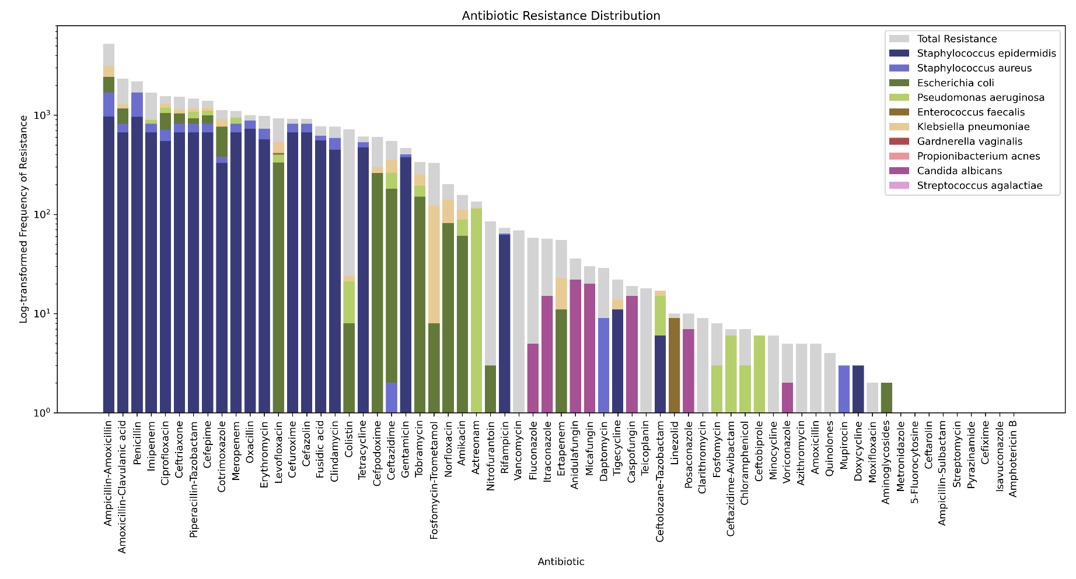
Antimicrobial resistance
2018 data

Slide 13
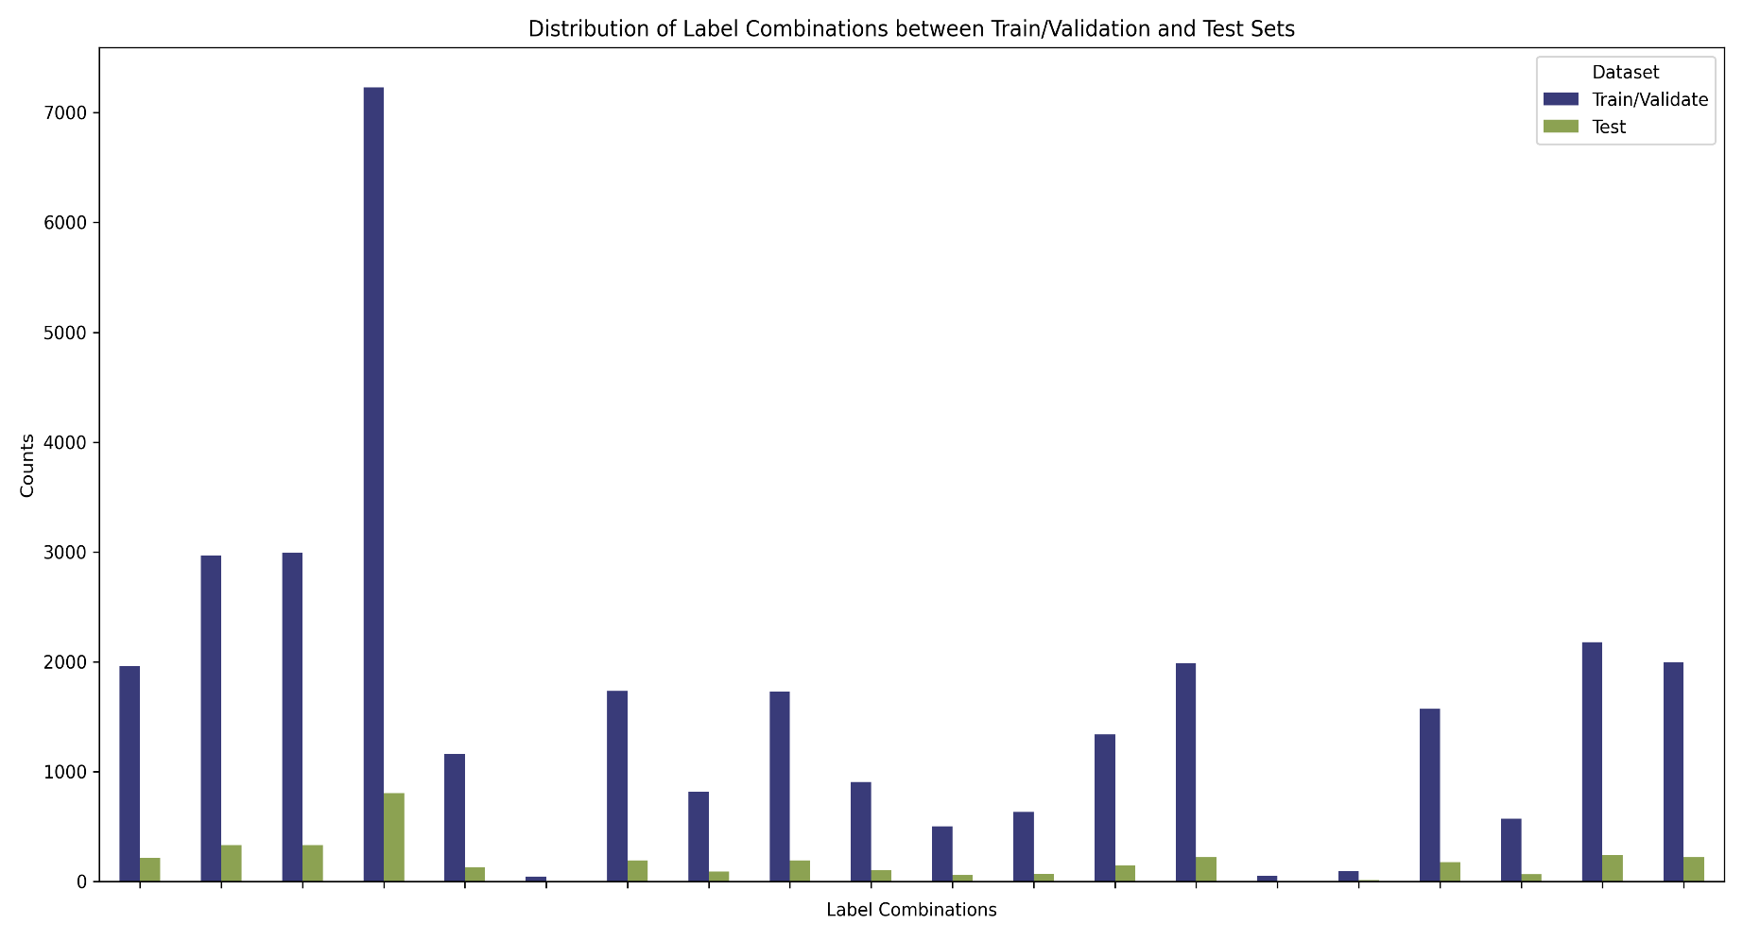
Antimicrobial resistance
Multilabel combinatorics and dataset splitting

Slide 14
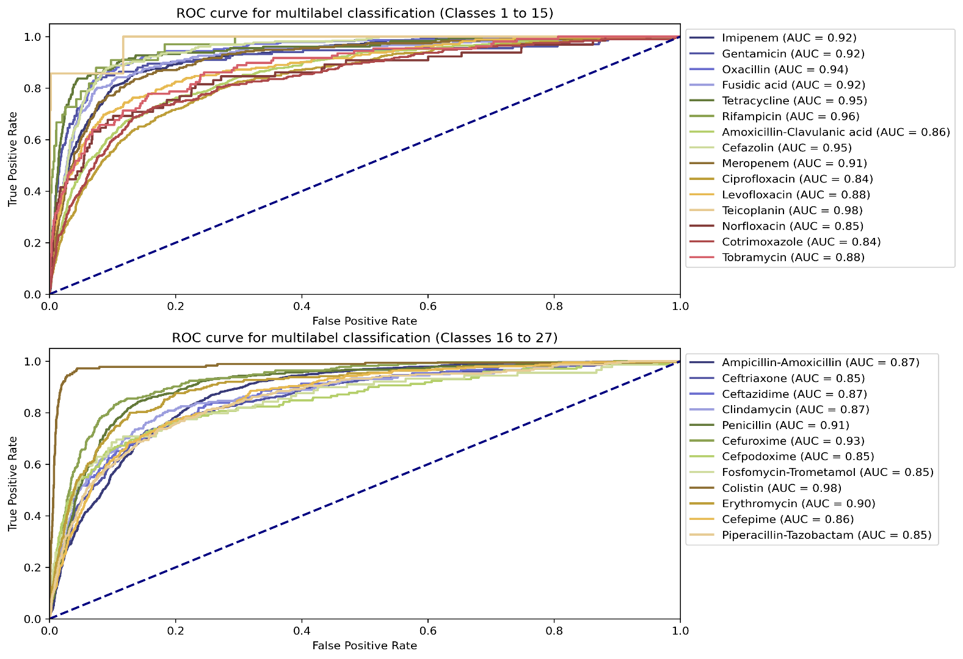
Antimicrobial resistance
Ridge classifier
Exact match accuracy: 74.43%
Hamming accuracy: 95.85%

Slide 15
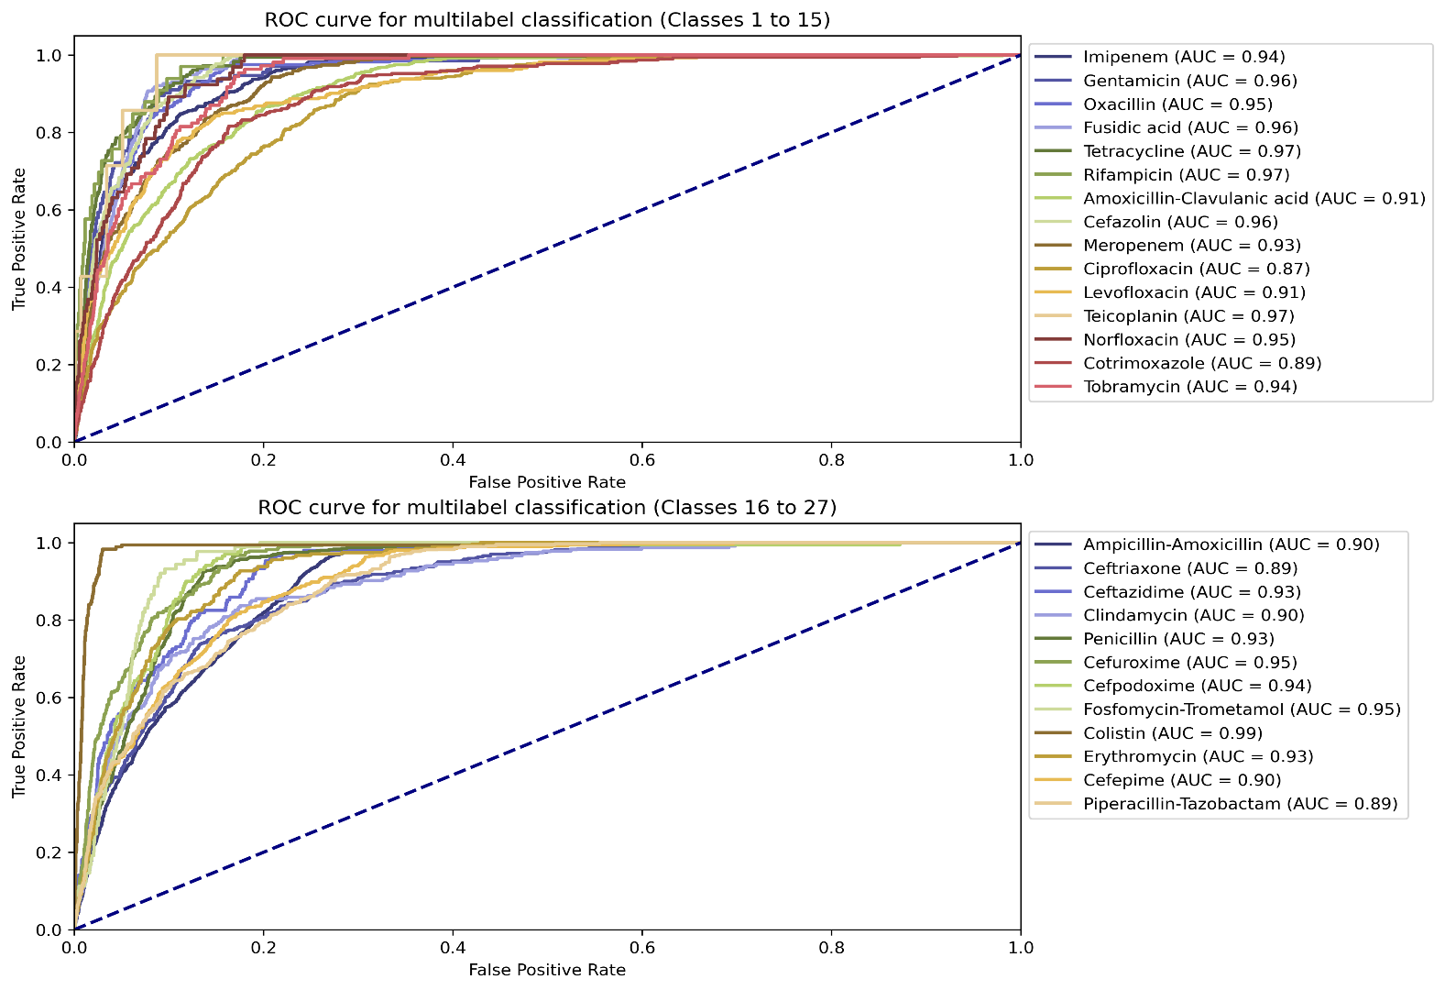
Antimicrobial resistance
Random Forest classifier
Exact match accuracy: 75.04%
Hamming accuracy: 95.95%

Slide 16
Antimicrobial resistance
CNN architecture here!

Slide 17
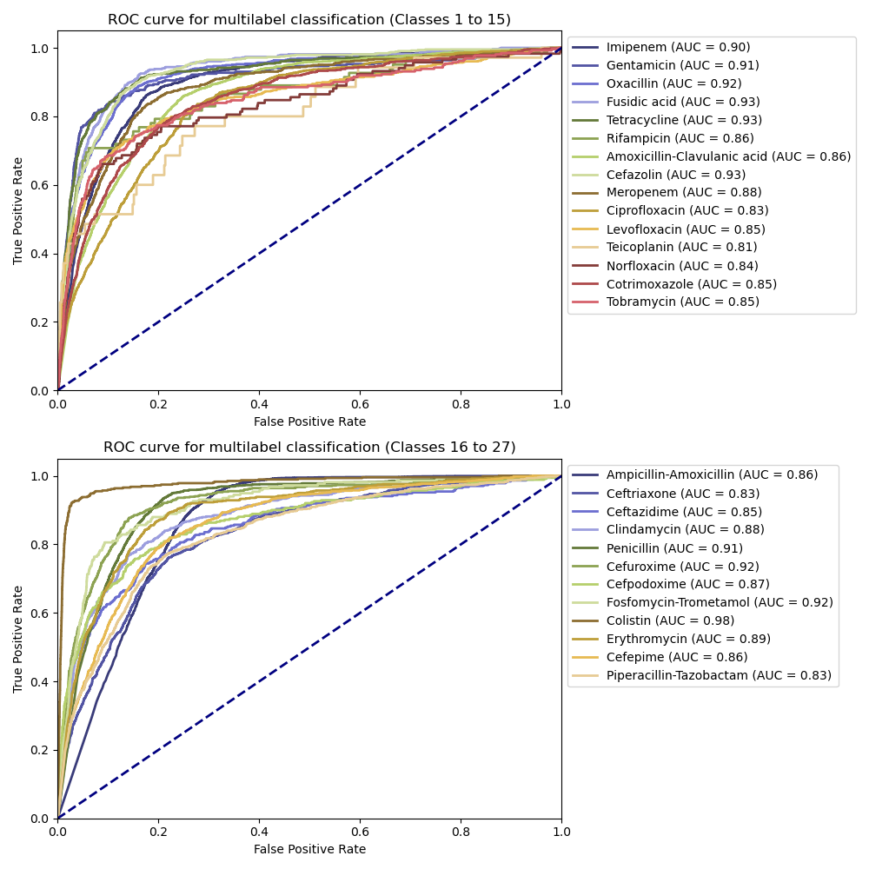
Antimicrobial resistance
CNN classifier
(Need some additional metrics here)

Slide 18
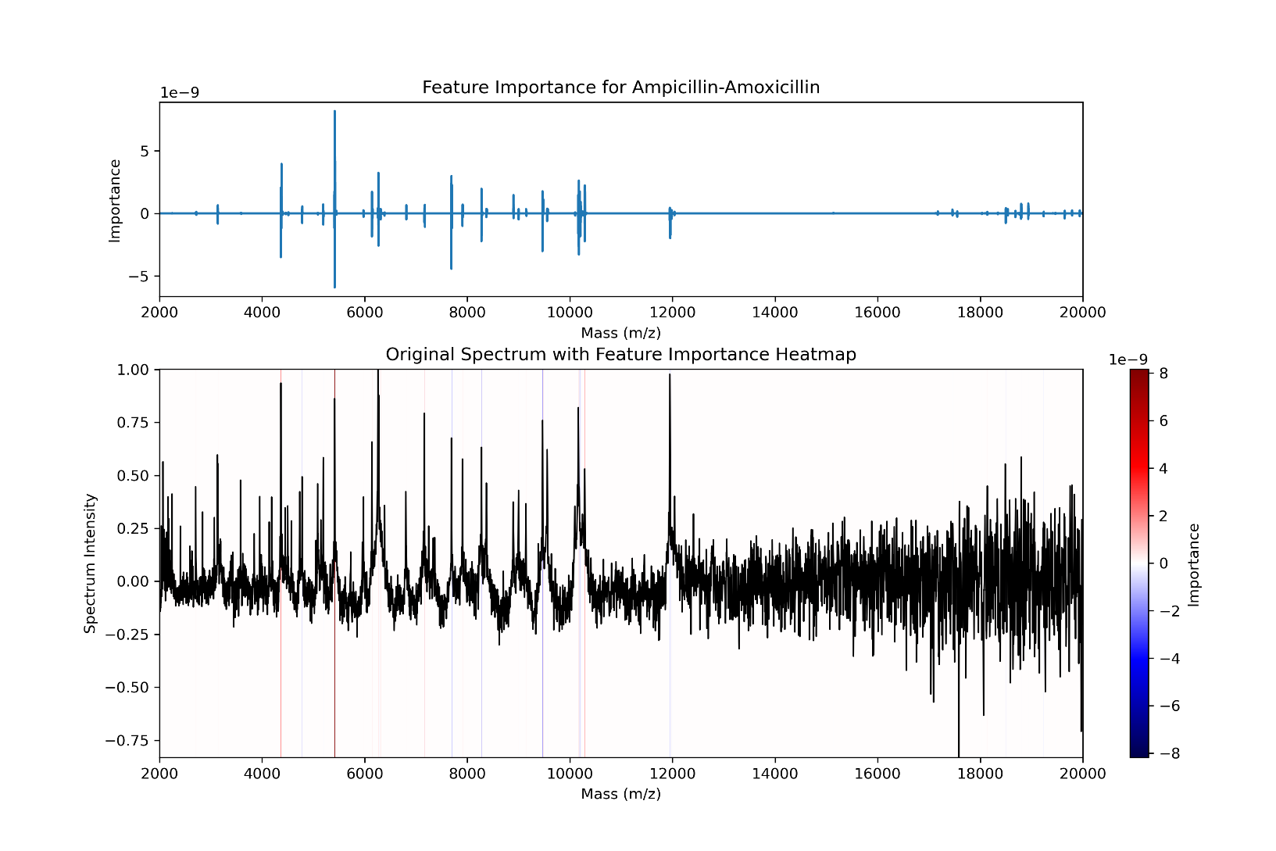
Antimicrobial resistance
GradCAM

Slide 19
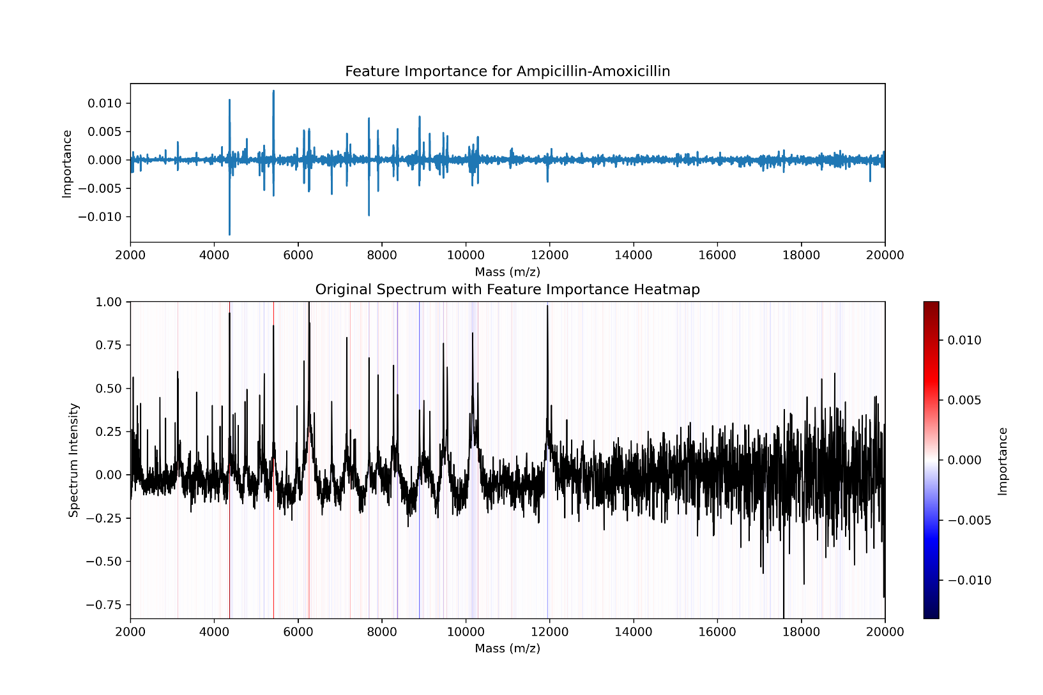
Antimicrobial resistance
Shapley values

Slide 20
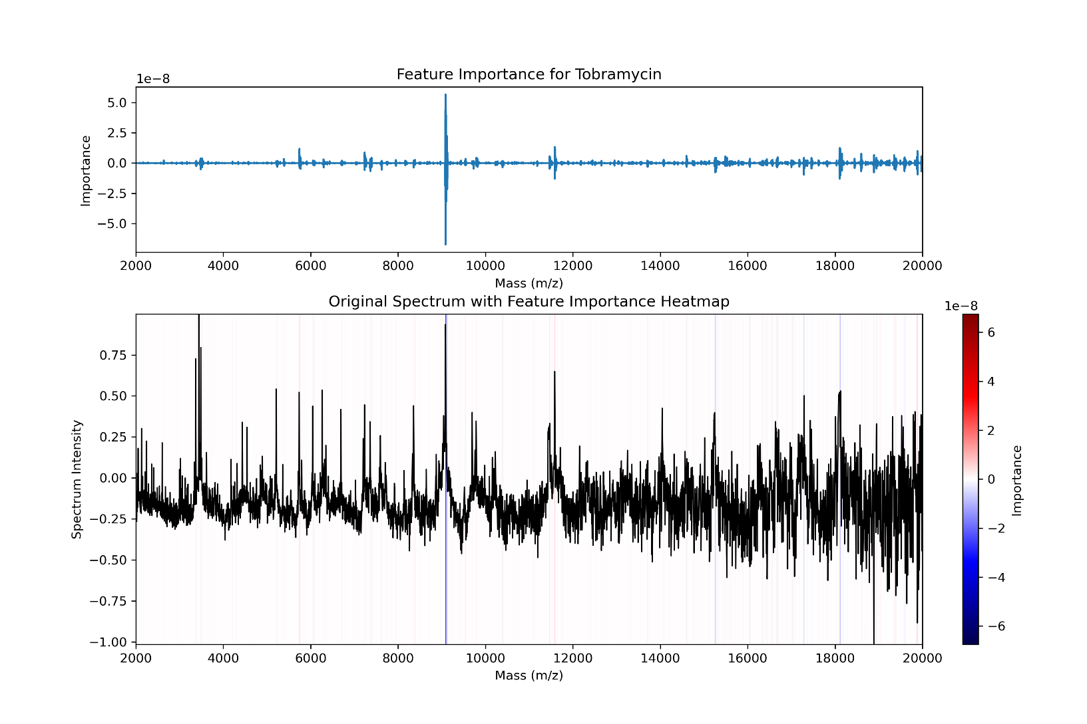
Antimicrobial resistance
GradCam

Slide 21
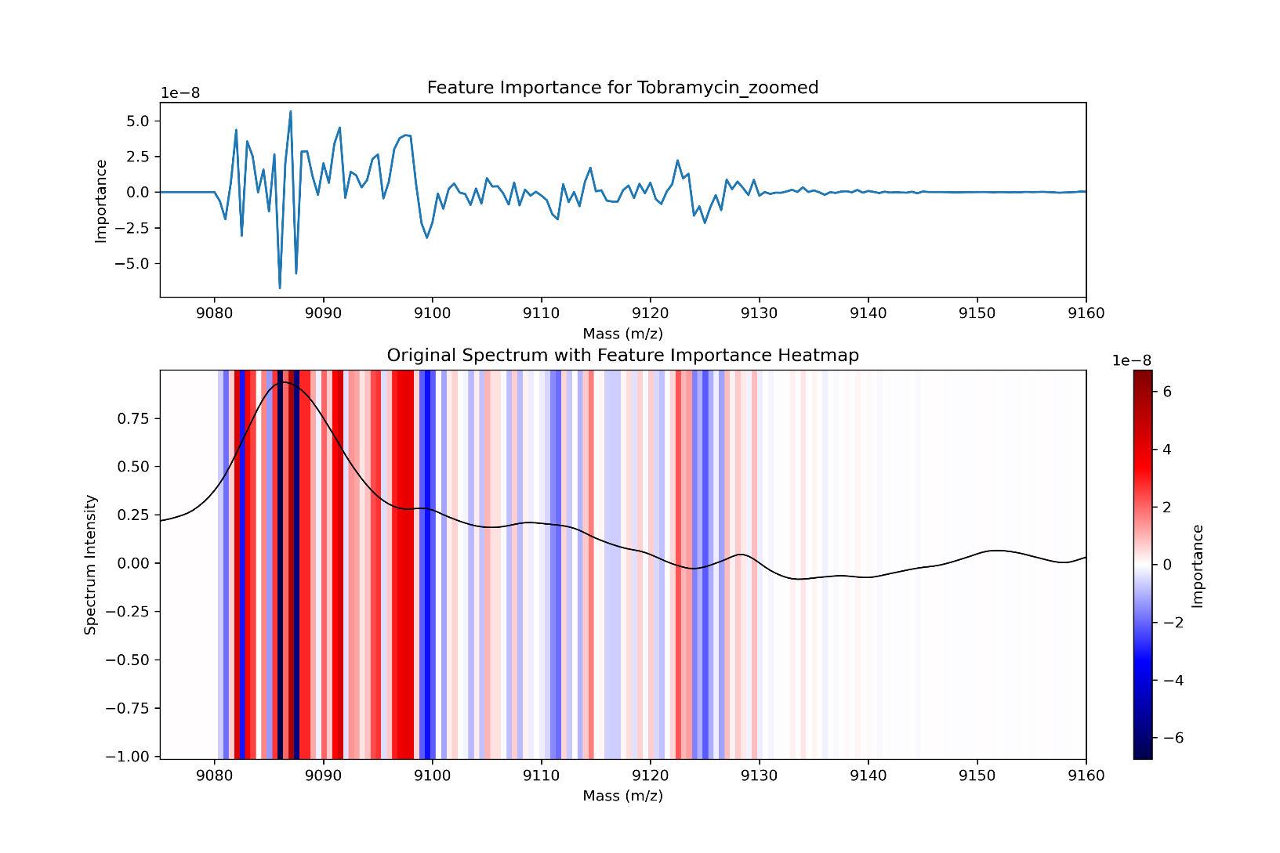
Antimicrobial resistance
GradCam

